Slide 1
Energy A.I. Hackathon 2023
Team Drillpy
April 11th, 2023
Abraham Montes, Çınar Turhan, Mohammad Abdullah, Ethan Litchauer
Petroleum and Geosystems Engineering, Electrical and Computer Engineering

Slide 2
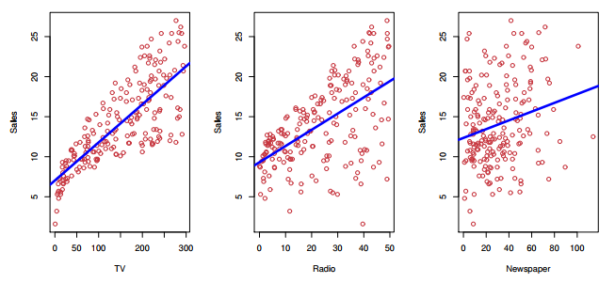
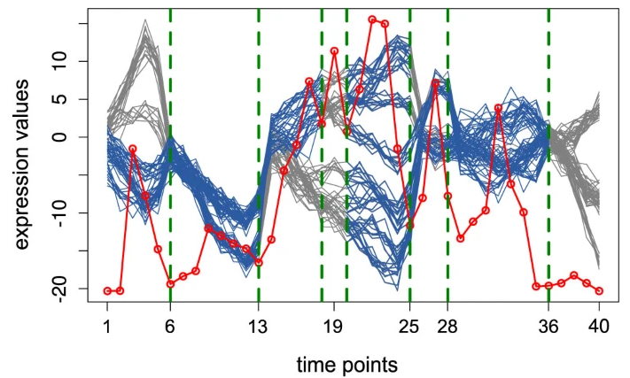
Agenda
Introduction
Why does it matter?
Work breakdown
How we hacked it
How we would hack it again
Wrap up
[James et al 2017]
[Omranian et al 2015]

Slide 3
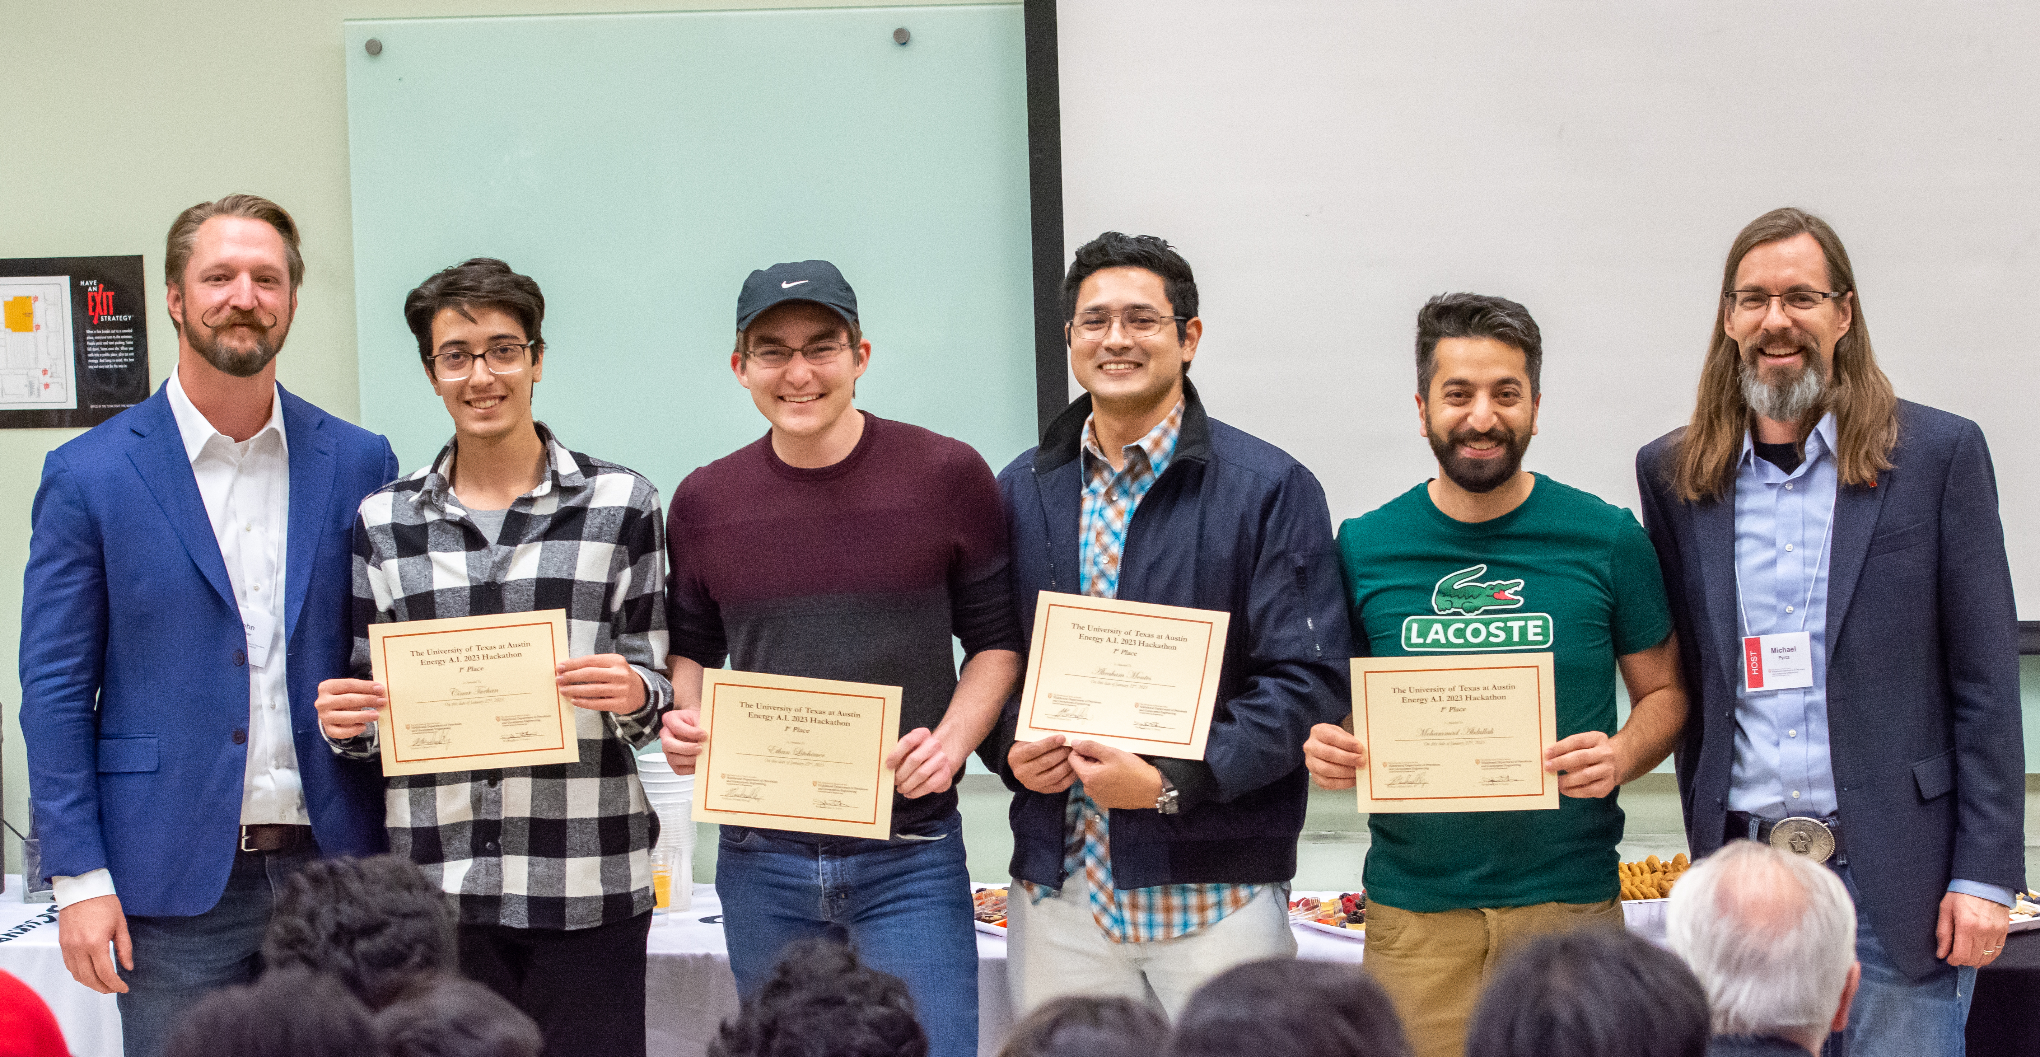
Introduction
Hacker
Cinar Turhan
Ethan Litchauer
Abraham Montes Mohammad Abdullah
Studies and Department
MSc student at PGE
BSc student at ECE
PhD student at PGE
PhD student at PGE
Research
Well repurposing
Integrated circuits
Stuck pipe prediction
Reservoir simulation

Slide 4
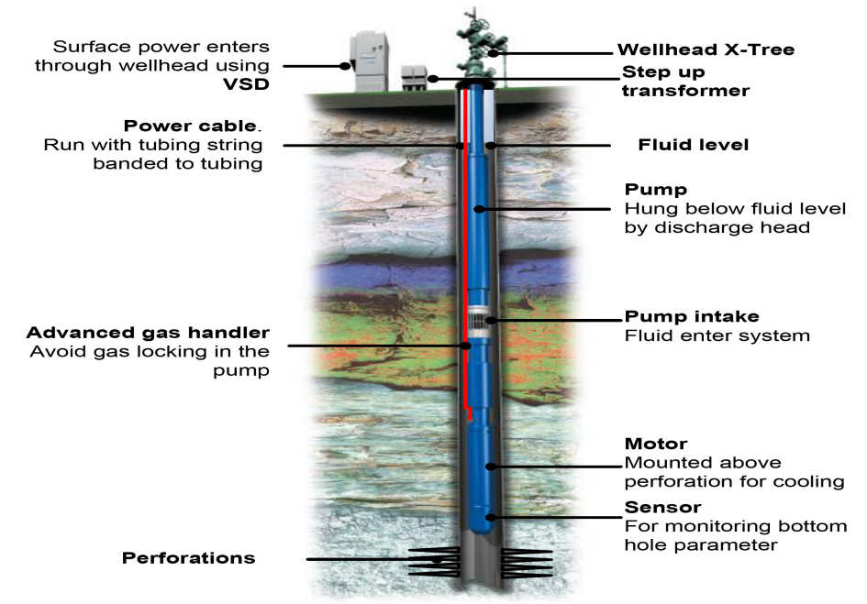
Why does it matter?
Logistics
Preventive maintenance
Aid design enhancement: RCA
Rig job scheduling
[Nuñez et al 2014]

Slide 5
Work breakdown
Literature Review
Exploratory Data Analysis
Model Selection
Feature Engineering
Model

Slide 6
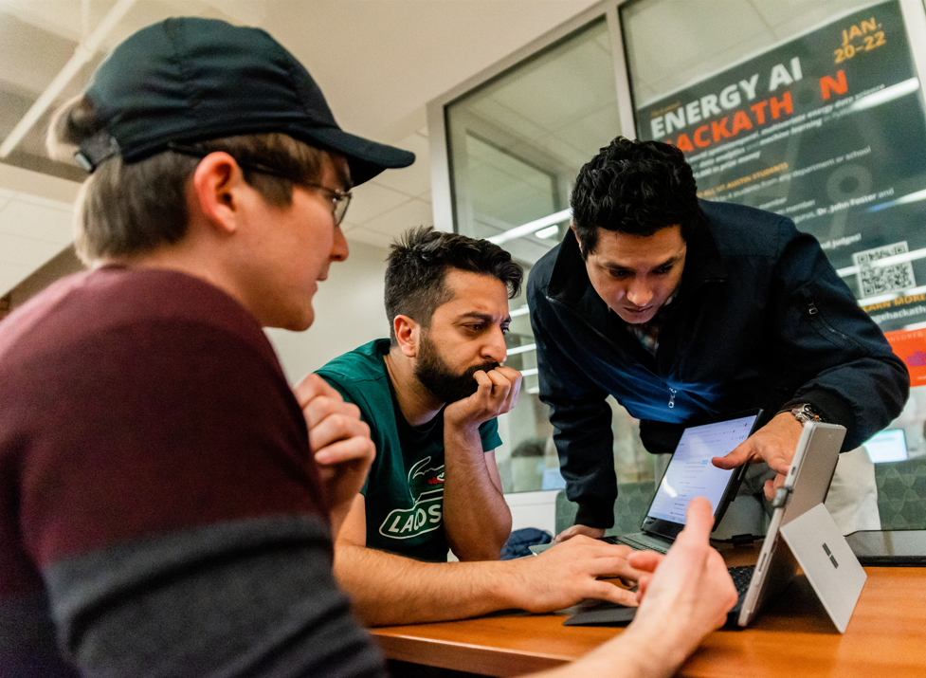
Work breakdown
Literature Review
Finding databases
Search based on title and abstract
Filtering the common features used in previous studies

Slide 7
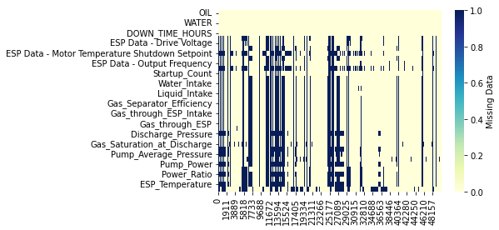
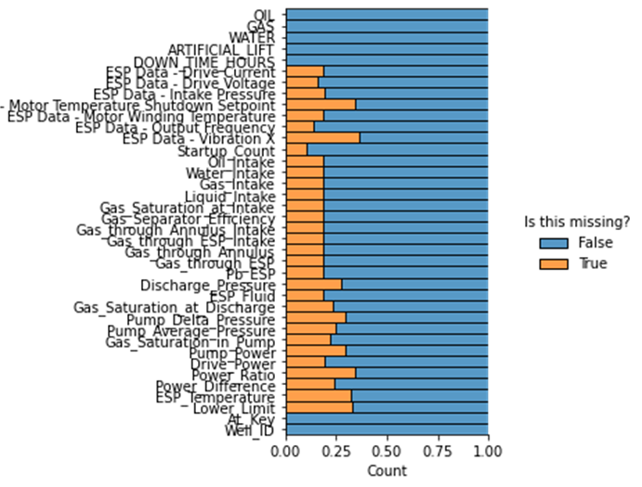
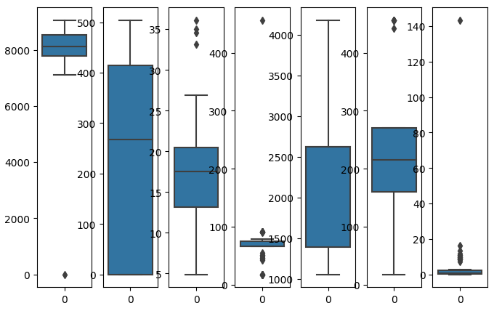
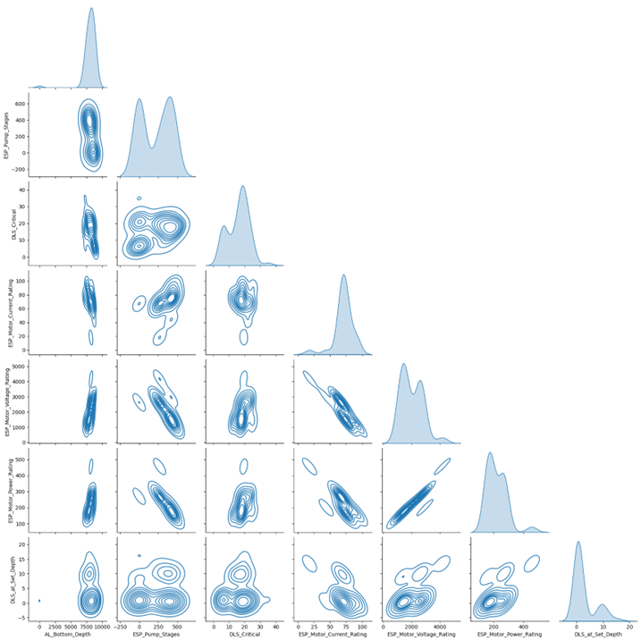
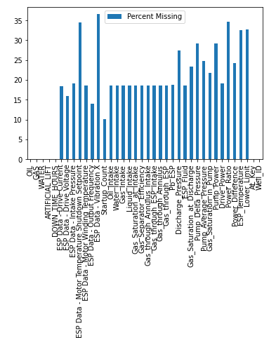
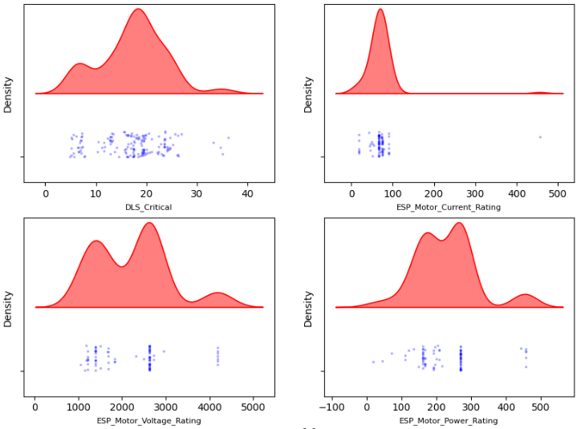
Work breakdown
Data is gold, right?
Exploratory Data Analysis
Data Completeness
Pairplots
Correlations
Outliers
Distributions

Slide 8
Work breakdown
Data is gold, right?

Slide 9
Work breakdown
Model Selection
Random Forest
SVM
Classification Problem
Noisy Data
High Dimensional Feature Space
Limited Time

Slide 10
Project Workflow
Literature Review
Exploratory Data Analysis
Model Selection
Random Forest Classifier
SVM Classifier
Clean and uncorrelated data
Feature Engineering
Technical information
Important Features
Model
Domain Knowledge
Hyperparameter Tuning

Slide 11
Work breakdown
Feature Engineering
Filter Data/Feature Selection
Sliding Window
Iteration Updates/K-Folds
Feature selection :
36 + 14 to 10 only
1. WOR
2. GOR
3. Frequency
4. ESP Current
5. ESP Voltage
6. Gas intake
7. Gas through annulus
8. Pump DP
9. Power difference
10. ESP Temp.

Slide 12
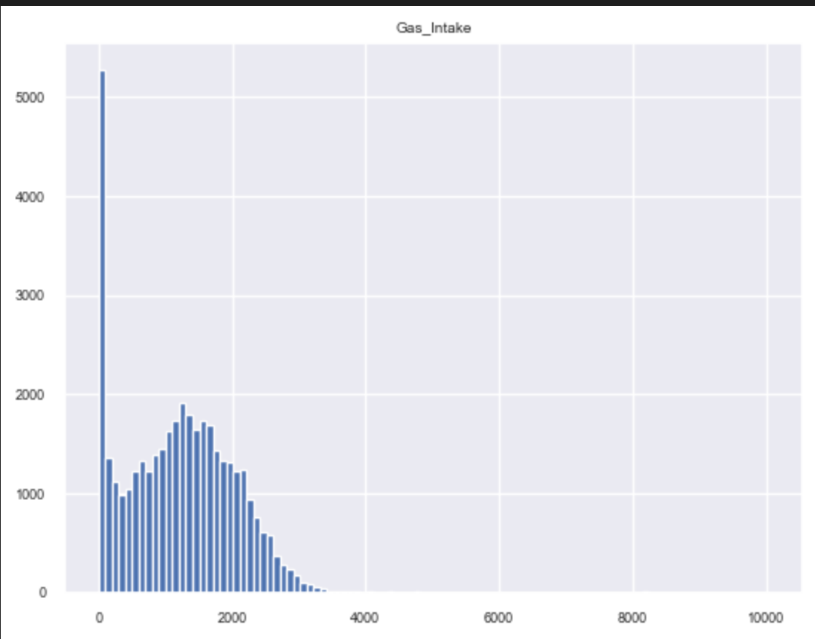
Work breakdown
Feature Engineering
Filter Data/Feature Selection
Sliding Window
Iteration Updates/K-Folds
Gas Intake

Slide 13
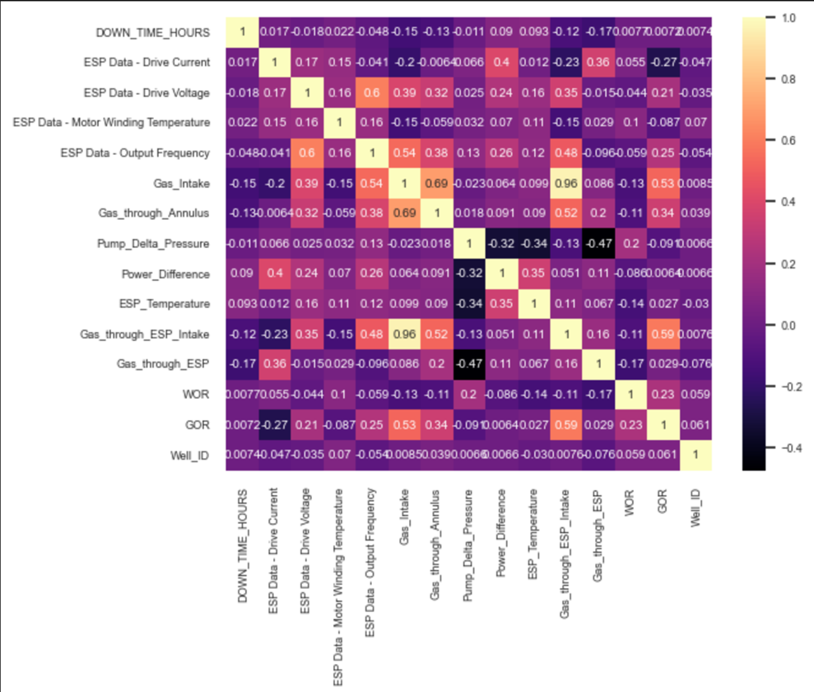
Work breakdown
Feature Engineering
Filter Data/Feature Selection
Sliding Window
Iteration Updates/K-Folds

Slide 14
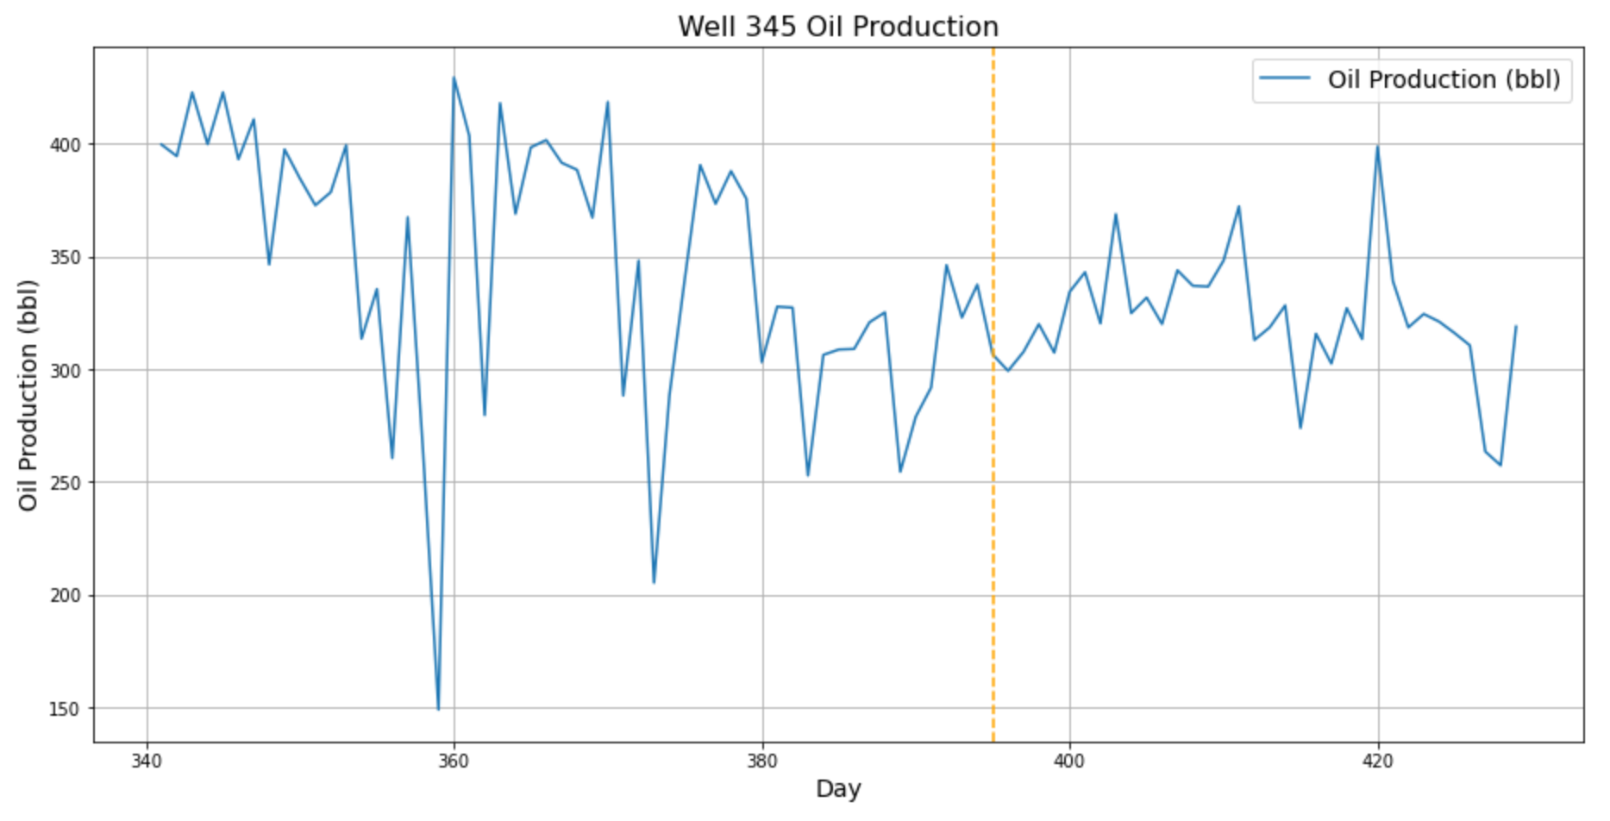
Work breakdown
Feature Engineering
30 Days
Filter Data/Feature Selection
Sliding Window
Iteration Updates/K-Folds
Mean, variance, and kurtosis
There is a trade-off

Slide 15
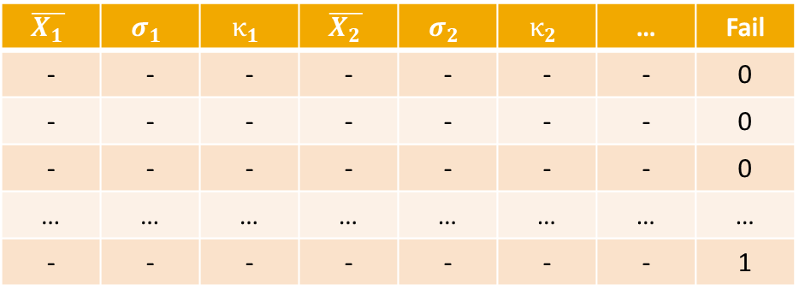
Work breakdown
Feature Engineering
The imbalance problem
Filter Data/Feature Selection
Sliding Window
Iteration Updates/K-Folds
$$\overline{X_{1}}$$ | $$σ_{1}$$ | $$κ_{1}$$ | $$\overline{X_{2}}$$ | $$σ_{2}$$ | $$κ_{2}$$ | … | Fail
- | - | - | - | - | - | - | 0
- | - | - | - | - | - | - | 0
- | - | - | - | - | - | - | 0
… | … | … | … | … | … | … | …
- | - | - | - | - | - | - | 1

Slide 16
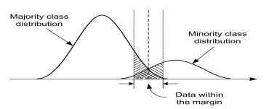
Work breakdown
Feature Engineering
Undersampling the majority class
Random undersampling
Accuracy alone was not our guiding star
What about oversampling and other sophisticated methods?
Dealing with imbalance
Filter Data/Feature Selection
Sliding Window
Iteration Updates/K-Folds
[He & Garcia 2009]

Slide 17
Model
Literature Review
Model
GridSeachCV for obtaining the best model accuracy.
Random Forest
Exploratory Data Analysis
Feature Engineering
Model Selection

Slide 18
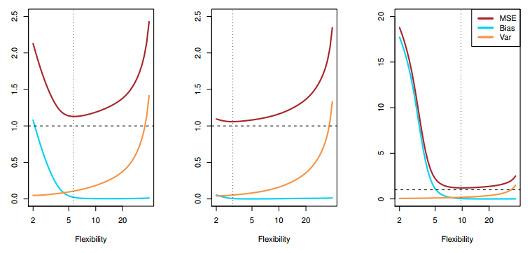
How we would hack it again
Increase the search space
$$E{\left[y_{0}−\hat{f}\left(x_{0}\right)\right]}^{2}=Var\left(\hat{f}\left(x_{0}\right)\right)+{\left[Bias\left(\hat{f}\left(x_{0}\right)\right)\right]}^{2}+Var\left(ε\right)$$
Model space: There is no free lunch.
Parameters and Hyperparameters: Informed search, instead of brute force.
Is the irreducible really irreducible?
The covariogram (what about the window size?)
[James et al 2017]

Slide 19
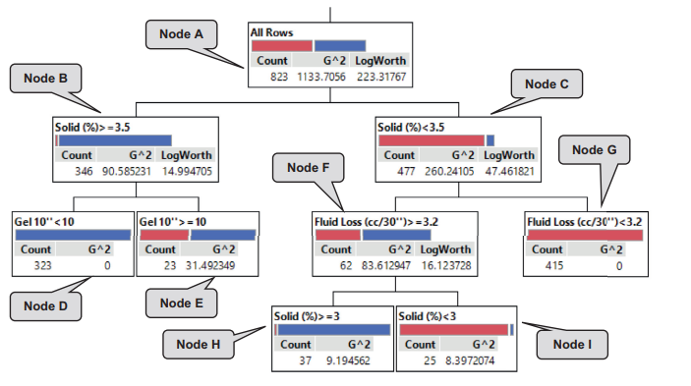
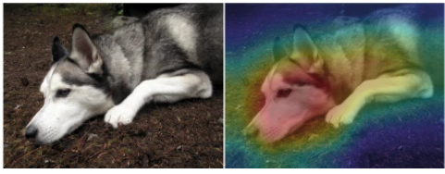
How we would hack it again
High-stakes decisions require interpretability
Explainable ML
Inherently Interpretable ML
[Rudin, et al 2019]
[Al Dushaishi, et al 2019]

Slide 20
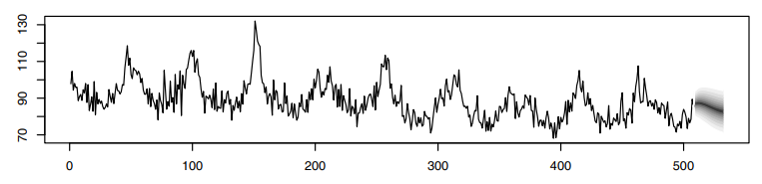

How we would hack it again
High-stakes decisions require to go beyond binary response
$$z_{t}\sim N\left(α z_{t−1}, σ^{2}\right)$$
$$α\sim N\left(μ_{α},σ_{α}^{2}\right)$$
$$σ^{2}\sim IG\left(μ_{α},σ_{α}^{2}\right)$$
[Shumway & Stoffer 2011]

Slide 21
Wrap up
Why the problem matters: Cost reduction
Work breakdown: Divide and succeed.
Data pre-processing tortuosity: Engineering the dataset.
Data imbalance: Undersampling approach.
Drillpy 2.0:
Widening the search space (e.g., model, window size).
Improved optimization of complexity and parameters.
Exploring distinct feature spaces.
Interpretability and uncertainty.

Slide 22

Thank you!!! Questions?

